Slide 1
Customer Lifetime Value Projection
Survival Analysis
RFM(recency, frequency, monetary) - https://en.wikipedia.org/wiki/RFM_(market_research)
BTYD (buy till you die) framework - https://en.wikipedia.org/wiki/Buy_Till_you_Die -
(1) - how frequently customers are buying while they are still "alive
(2) - dropout process (how likely a customer is to churn in any given time period)
Common versions of the BTYD model include:
The Pareto/NBD model:
dropout process as a Pareto Type II distribution (Lomax distribution - https://en.wikipedia.org/wiki/Lomax_distribution)
purchase frequency process as a Negative Binomial Distribution - https://en.wikipedia.org/wiki/Negative_binomial_distribution
The Beta-Geometric / Beta-Binomial model:
the dropout process as a Geometric distribution with a beta mixing distribution
whether or not a customer made a purchase in a period of time as a binomial distribution with a beta mixing distribution
Churn rate = attrition rate : number of customers "moving out" over a specific period of time - https://en.wikipedia.org/wiki/Churn_rate
mixing distribution – a distribution of parameters of distributions

Slide 2
Survival Analysis
Survival Function 𝑆(𝑡)=𝑃𝑟(𝑇>𝑡) - probability of surviving past time 𝑡.
Hazard Function - probability of the death event occurring at time 𝑡, given that the death event has not occurred until time 𝑡.
Survival Analysis - measure lifespans of individuals (different nations, different groups of people, population stricken by a disease). Recently applied in business for any durations - time between childbirths, length of subscriptions to services, life-time of a customer, time it takes for a user to enter a webpage, etc.
Censoring:
right-censored - individuals in population who are not dead yet.
left-censored - individuals who had pre-history at t=0
Simple example of censoring:
if our population consists of two groups with lifespans 2 and 12 months, and we look at data at t=10 – and measure the lifespan not including the right-censored (still alive) individuals, we will get ~ 2 months, which is only the first group.
If we instead simply took the mean of all observed lifespans, including the current lifespans of right-censored instances, we would still be underestimating the true average lifespan.
https://lifelines.readthedocs.io/en/latest/ - lifelines
- conda install -c conda-forge lifelines
https://scikit-survival.readthedocs.io/en/latest/ - sksurv
- https://github.com/sebp/scikit-survival
- conda install -c sebp scikit-survival
Cumulative Hazard Function H(t) - the integral above. So:

Slide 3
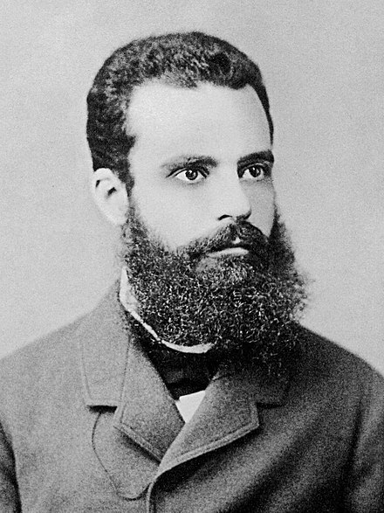
Pareto distribution
Pareto distribution - a power-law probability distribution - named after Vilfredo Pareto.
It is also called tail function of survival function.
Originally was used to fit the distribution of wealth in a society – showing that a large portion of wealth is held by a small fraction of the population.
The Pareto principle or "80-20 rule" stating that 80% of outcomes are due to 20% of causes was named in honor of Pareto.
If X is a random variable with a Pareto (Type I) distribution, then the probability that X is greater than some number x
is given by
Vilfredo Pareto
(1848 - 1923)
https://en.wikipedia.org/wiki/Vilfredo_Pareto
Italian civil engineer, economist, and sociologist

Slide 4
Negative Binomial Distribution (NBD)
NBD = discrete probability distribution - number of successes
in a sequence of independent and identically distributed Bernoulli trials
before a specified number of failures (r) occurs.
- https://en.wikipedia.org/wiki/Negative_binomial_distribution
The probability mass function of the NBD:
where

